Slide 1

Crude Oil Price Prediction
Group : 3
Mentor : Vinod & Deepika

Slide 2


Team Members
Sanket Dhole
Rooba Dharshini
Dalmiya Candace Denzil
Thakur Aashish Singh
Hariharan
Nikhil

Slide 3

Objective
Oil is a commodity notorious for being able to go in the complete opposite direction after a single market event.
This is because the fundamentals of oil price are rarely based on real-time data, instead, it is driven by externalities making our attempt to forecast it even more challenging.
As the economy will be highly affected by oil prices. Our model will help to understand the pattern in prices to help the customers and businesses to make smart decisions.

Slide 4
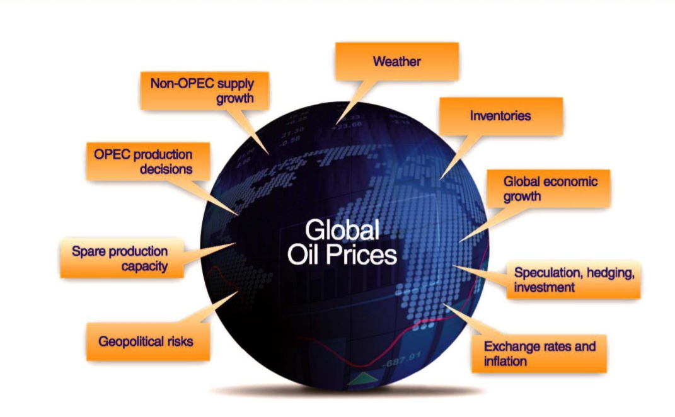
Factors Affect the oil price
Many factors affect the price of oil, but in the end it comes down to supply and demand

Slide 5

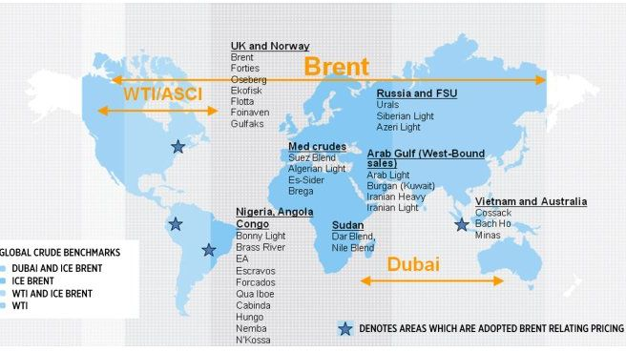
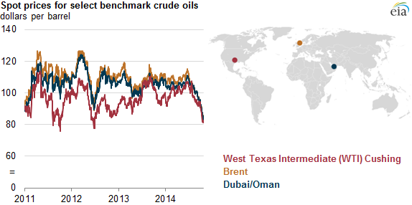
A benchmark crude is a crude oil that serves as a reference price for buyers and sellers of crude oil.
There are three primary benchmarks
West Texas Intermediate (WTI)
Brent Blend
Dubai Crude.

Slide 6
Project Architecture / Project Flow
Data Collection
Explore & Visualizations
Data Processing
Partition Series
Model Building
Evaluate & Compare Performance
Deployment

Slide 7
Data Collection

Slide 8
Web Scraping
Oil Price data was scraped from eia.gov.
Challenges faced:
Data from original website (eia.gov/) is not allowing to scrape. However, to demonstrate the web scraping using beautifulsoup we scraped the data from github. Albeit, we will not use this data for project as this dataset is not from a reliable source.

Slide 9
Dataset
Downloaded the Brent oil price dataset from U.S. Energy Information Administration (EIA) website.
Dataset consist of 3rd Oct 2016 to 22nd Nov 2021 (5 years) of daily oil price.

Slide 10
Explore & Visualizations

Slide 11
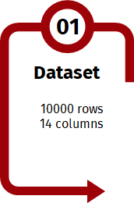
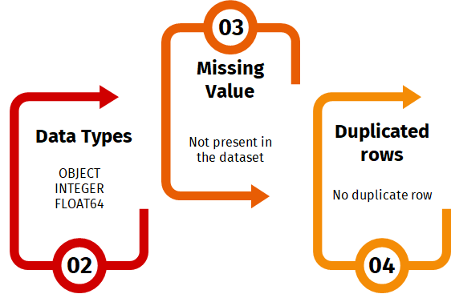
Inferences from Data-Set
1309 Rows
2 Columns
Datetime
Float

Slide 12
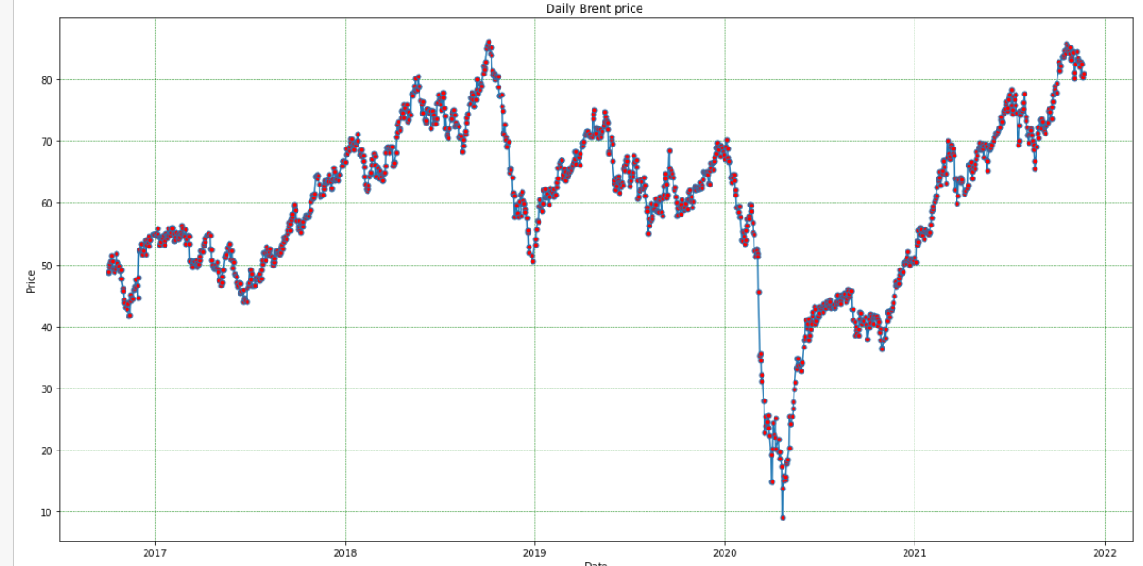
Line Plot
Inferences :
Trend:
The price was steady till end of 2019 ($50 to $70)
At the beginning of 2020, oil prices had declined by about $20 a barrel due to Covid,
It was observed that after the drop, towards the beginning of 2021 price started to climb to the precovid numbers.
Seasonality :
We can see some weak seasonality from the data.

Slide 13
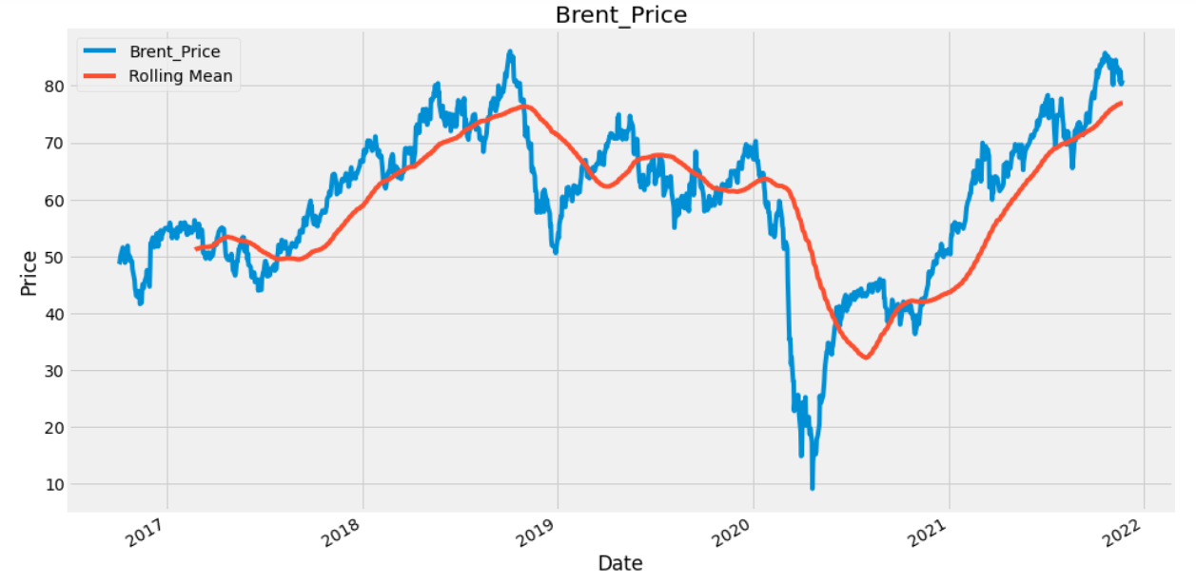
Stationarity:
As the Mean is changing in different time period we can say the data is not stationary.

Slide 14
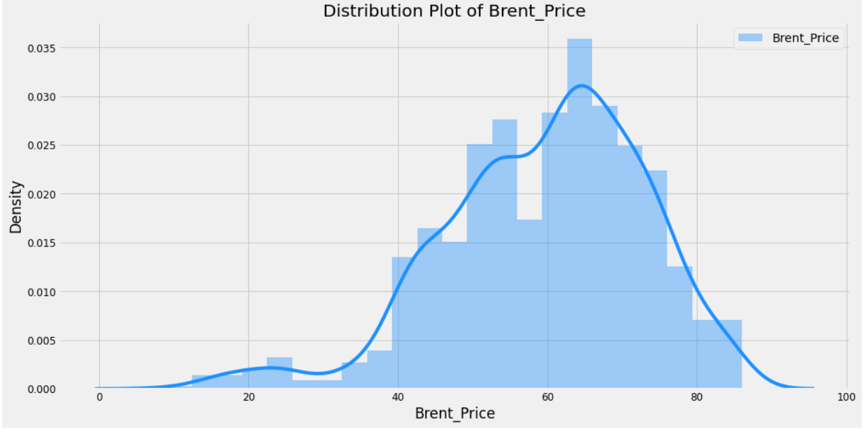
Histogram and Distribution Plot
Inferences :
Most frequent values of Brent are in the range of 61 to 69.
The Brent oil price values from 0 to 35 are less frequent.
It show the data doesn't follow Normal Distribution.
Left skewed data

Slide 15
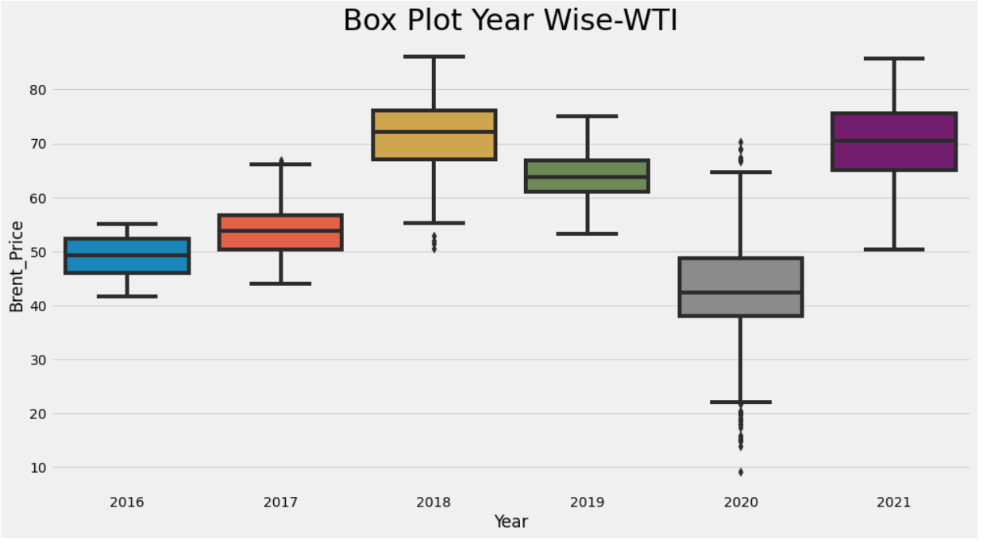
Box Plot Year Wise
Inferences :-
2017(june) to 2018 (oct) was the boom year for oil market.
Years 2018 and 2020 show outliers.
2018
The price of oil dropped in November 2018 because of number of factors, including "rising petro-nations' oil production, the U.S. shale oil boom, and swelling in North American oil inventories," according to Market Watch.
2020
As rising Covid cases prompted fears of demand slowdown, due to that the price of the oil dropped.
Notes:
-INFERENCES-
In the above diagram we can see the year 2020 has outliers it was due to the pandemic situation.
but we can also see some of the outliers in the year 2018 ,
The impact of higher oil prices on global growth will depend on two elements: i) the factors responsible for the movement (supply, demand, or others)
Actually 2017(june) to 2018 (oct) was the boom year for oil market.
Due the oil market was in a situation in which supply persistently exceeded demand
As the months passed the price of oil dropped in November 2018 because of a number of factors, including
"rising petro-nations' oil production,
the U.S. shale oil boom,
and swelling in North American oil inventories," according to Market Watch.
After sudden decrease in oil prices at continuous interval may have cause some outliers.
—-----------------------------------------------------------------------------------------------------------------------------------------------------------------------------------------------------------------
-ON THIS BASIS I HAVE TAKEN THE INFERENCES-
For 2020 ( pandemic situation reason)
as rising Covid cases prompted fears of a demand slowdown. West Texas Intermediate crude futures declined more than 4% at one point to trade as low as $65.15, a level not seen since May. The contract recovered some of those losses during afternoon trading and ultimately settled 2.64% lower at $66.48 per barrel. International benchmark Brent crude settled at $69.04 per barrel for a loss of 2.35%, after hitting a low of $67.60.^{[153]} The biggest challenge for oil markets remains the uncertainty around COVID as the ‘delta variant’ has made for the highest daily case counts since early 2021,” Bank of America said.
For 2018 ( rise and then why falling)
The production capacity in Venezuela had decreased. United States sanctions against Iran, OPEC's third-biggest oil producer, were set to be restored and tightened in November.^{[85]}
The price of oil dropped in November 2018 because of a number of factors, including "rising petro-nations’ oil production, the U.S. shale oil boom, and swelling North American oil inventories," according to Market Watch.^{[86]}
The 1 November 2018 U.S. Energy Information Administration (EIA) report announced that the US had become the "leading crude oil producer in the world" when it hit a production level of 11.3 million barrels per day (bpd) in August 2018, mainly because of its shale oil production.^{[87]} US exports of petroleum—crude oil and products—exceeded imports in September and October 2019, "for the first time on record, based on monthly values since 1973."^{[6]}
When the price of Brent oil dropped rapidly in November 2018 to $58.71,^{[88]} more than 30% from its peak,^{[89]}—the biggest 30-day drop since 2008—factors included increased oil production in Russia, some OPEC countries and the United States, which deepened global over supply, were factors in the crash.^{[88]}

Slide 16
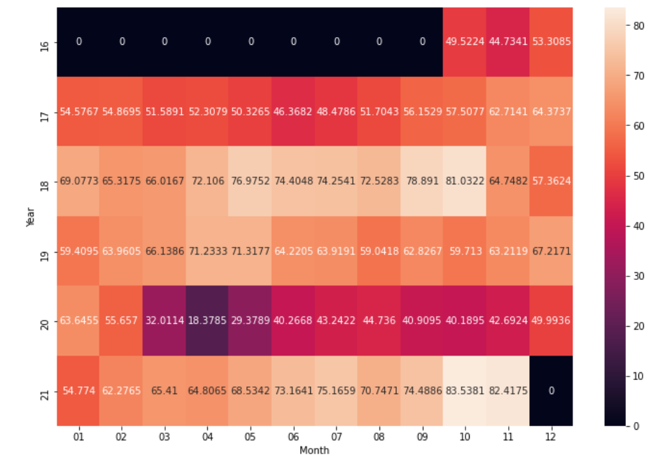
Heat Map
The darker the colour the lesser the value and lightest the colour the highest the value.
Oct 2018 -
The average price of crude oil per barrel was high - with average value as 81.032
Apr 2020
Due to pandemic and amid global crisis these prices shows a steep downfall - to as low as 18.37.
The all time high prices can be seen in recent months post epidemic in the month of Oct 2021 as high as 83.53 with continuation of rally in following month of Nov 2021 with price as 82.41.
Finally, we can say that the prices are getting normal and touching highest which is a good symbol that now we have a stable demand of crude oil.
Notes:
The above heat map depicts overall story of Brent crude oil prices from Oct 2016 to Nov 2021. This map has mean values of per barrel price in USD of Brent crude oil of each month in each year. On Y axis we have Year and on X axis we have month. In addition, each cell is filled with average price of Crude oil.
It is evident that this dataset is having data from Oct 2016 to Nov 2021. As in map, the year 2016 has some months containing values as 0 and in year 2021 Dec column shows as value 0 because we do not have data for these months in our dataset.
The darker the colour the lesser the value and vice versa, lightest the colour the highest the value.
This heatmap shows that the average price of crude oil per barrel was high in Oct 2018 with average value as 81.032 and due to pandemic and amid global crisis these prices shows a steep downfall in Apr 2020 to as low as 18.37. Moreover, the all time high prices can be seen in recent months post epidemic in the month of Oct 2021 as high as 83.53 with continuation of rally in following month of Nov 2021 with price as 82.41. Finally, we can say that the prices are getting normal and touching highest which is a good symbol that now we have a stable demand of crude oil.

Slide 17
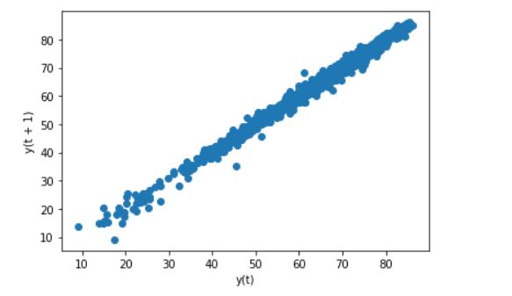
Lag Scatter Plot
A lag plot is a special type of scatter plot in which the X-axis represents the dataset with some time units behind or ahead as compared to the Y-axis
The difference between these time units is called lag.
Inferences :-
Lag plot indicates that oil prices had good positive correlation relationship.
Hence,this series is good for time series modelling as its showing autoregressive nature.
Notes:
A lag plot is a special type of scatter plot in which the X-axis represents the dataset with some time units behind or ahead as compared to the Y-axis. The difference between these time units is called lag or lagged and it is represented by k.

Slide 18
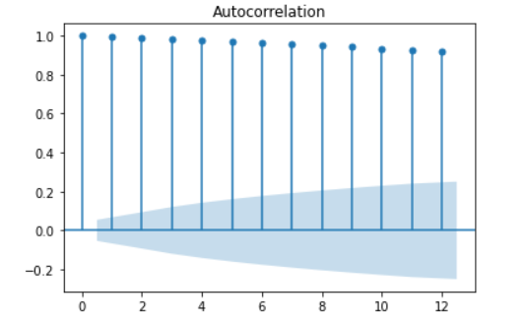
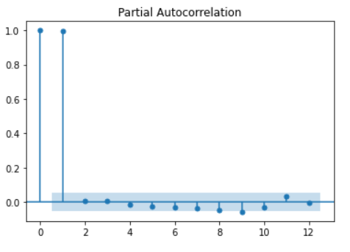
Autocorrelation
To check the autocorrelation between the lagged values( yt - yt-1 ) at any stage is strong enough to build a model we will use the concept of
ACF (Autocorrelation Function)
PACF(Partial Autocorrelation Function)
In this plot, the two dotted lines on either sides of 0 are the confidence intervals. These can be used to determine the ‘p’ and ‘q’ values as:
p – The lag value where the PACF chart crosses the upper confidence interval for the first time. If you notice closely, in this case p=1.
q– The lag value where the ACF chart crosses the upper confidence interval for the first time. If you notice closely, in this case q=1.

Slide 19
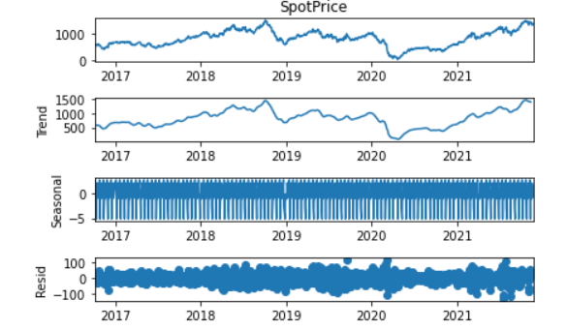
Decomposition plot

Slide 20
Data Processing

Slide 21
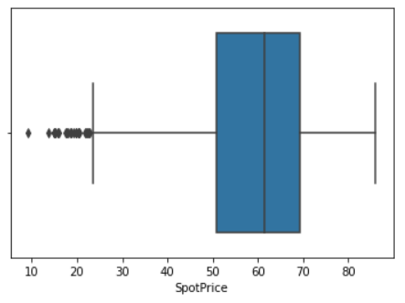
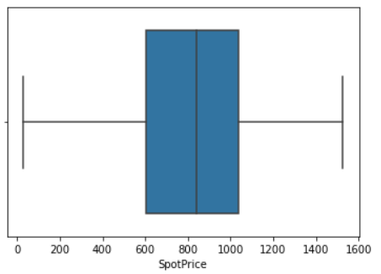
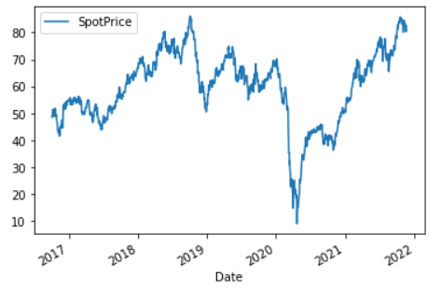
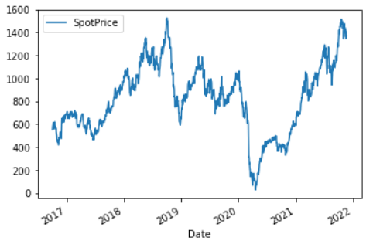
Outlier Correction
To treat the outlier we used box cox method which has eliminated outliers.
Before treating outlier
After treating outlier

Slide 22
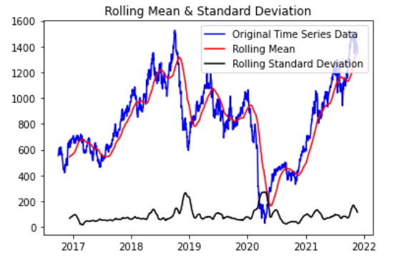
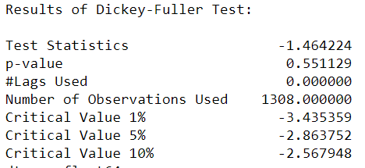
Stationarity
A Stationary series is one whose statistical properties like mean, variance,do not vary with time
Check for Stationarity
Plotting Rolling Statistics:
Plot the moving average or moving variance and see if it varies with time
Dickey-Fuller Test:
One of the statistical tests for checking stationarity.
From the above information we can say that data is non stationary .
p-value > 0.05: Accept the null hypothesis (H0), the data has a unit root and is non-stationary.
p-value <= 0.05: Reject the null hypothesis (H0), the data does not have a unit root and is stationary.
Notes:
A Stationary series is one whose statistical properties like mean, variance, covariance do not vary with time or these stats properties are not the function of time.In other words, stationarity in Time Series also means series without a Trend or Seasonal components.

Slide 23
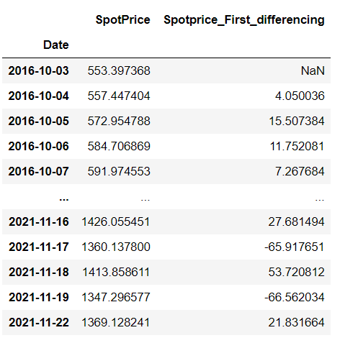
Converting non stationary to stationary
To convert non stationary to stationary we have used Differencing technique.
In differencing we subtract the values of the series with the values of the previous time periods.

Slide 24
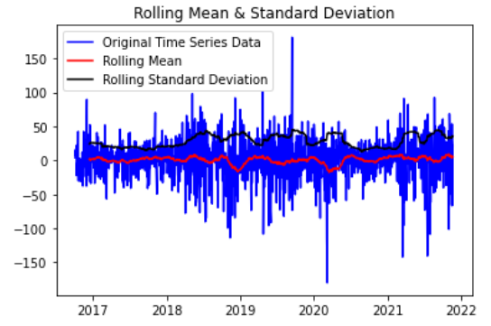
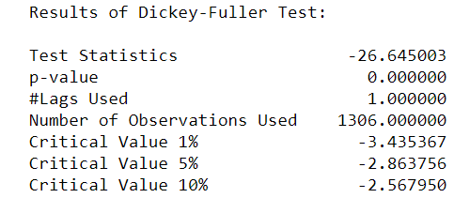
Checking Stationarity with Dickey-Fuller Test after Differencing
Notes:
If it is not stat….then its not possible for ARIMA model building
Dicky fuller test

Slide 25
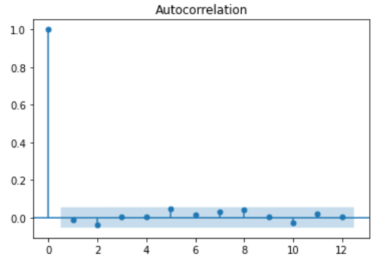
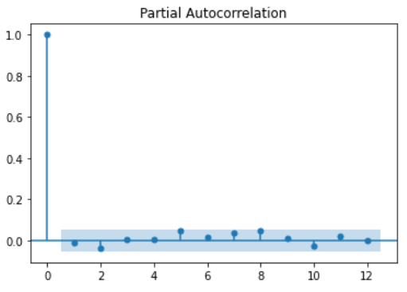
ACF and PACF plot after differencing
In this plot, the two dotted lines on either sides of 0 are the confidence intervals. These can be used to determine the ‘p’ and ‘q’ values as:
p – The lag value where the PACF chart crosses the upper confidence interval for the first time. If you notice closely, in this case p=0
q– The lag value where the ACF chart crosses the upper confidence interval for the first time. If you notice closely, in this case q=0

Slide 26
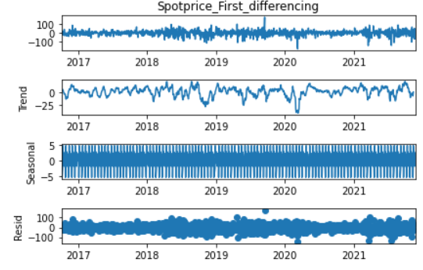
Decomposition plot after Differencing

Slide 27
Partition Series

Slide 28
Splitting the data into test and train
The final data after data processing was split into train data and test data
Training Data :1083 (3rd Oct 2016 to 31st Dec 2020)
Test Data :226 (1st Jan 2021 to 22nd Nov 2021)

Slide 29
Model Building
Model | Order | Mape Value
ARIMA | 0,1,0 | 4.33921
SARIMA | 0,1,0,5 | 1.12060
LSTM | - | 70.17022
The Forecast model was build based on SARIMA Model has it gives the least MAPE value

Slide 30
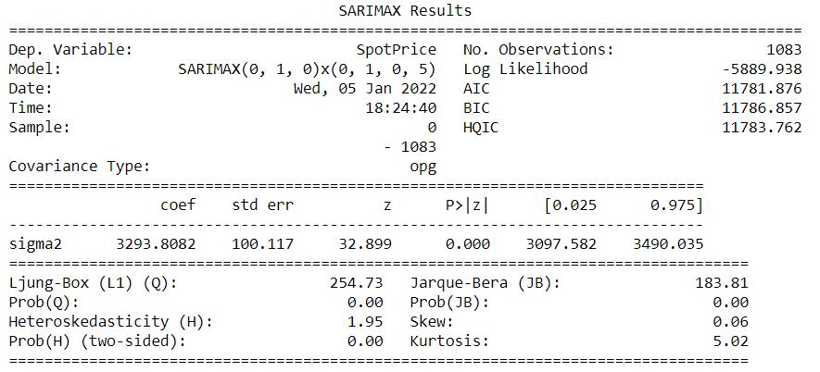
SARIMA Model Summary

Slide 31
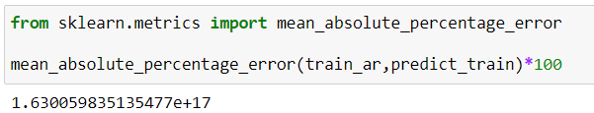

Train MAPE Value
Test MAPE Value

Slide 32
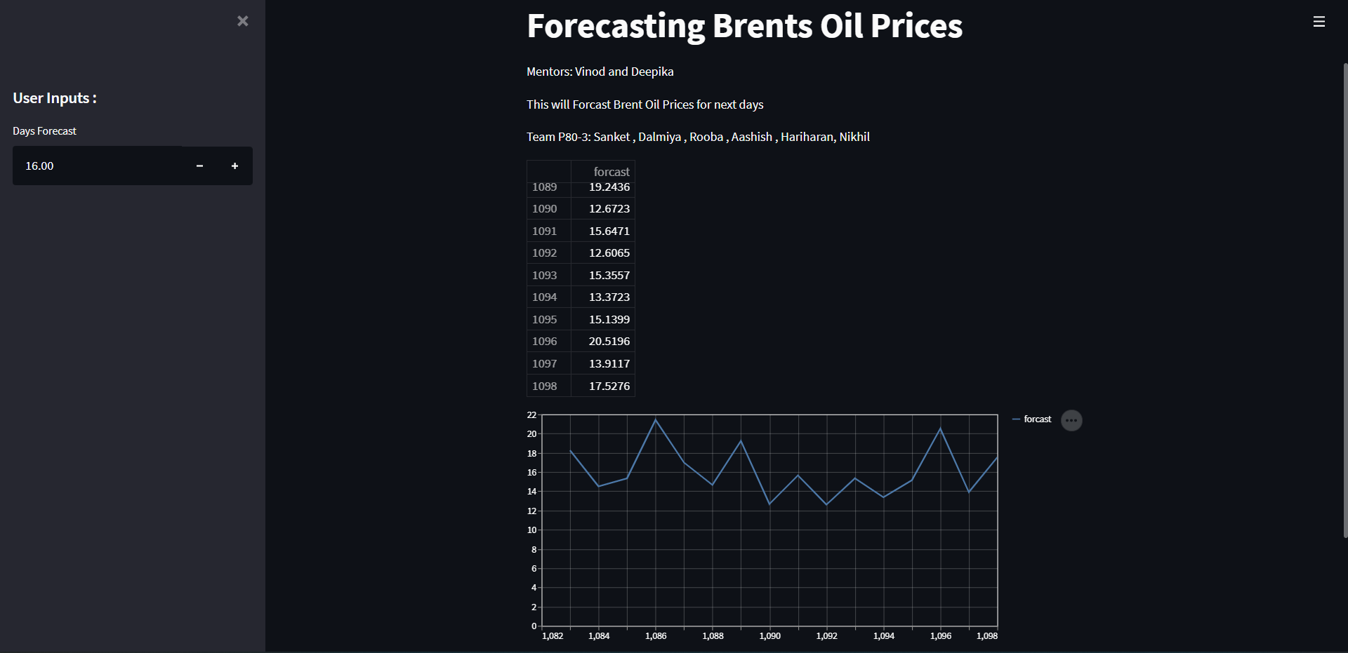
Model Deployment Using Streamlit

Slide 33
CHALLENGES FACED
Webscrapping
Eliminating Outlier
CHALLENGES
Model Building
Increasing Model accuracy

Slide 34
CONCLUSION AND IMPROVEMENTS
It can be inferred that on the whole a SARIMA Model provides the best result in terms of accuracy for the given dataset.
Outliers in the data have been removed using box cox method for better accuracy and better forecasting result.
To make the data stationary , differencing method gave the least p-value.
The above improvements have helped in getting a good accuracy for the final model.

Slide 35
Thank You

